Slide 1
LE_Road Sign Detection
Submitted in the partial fulfillment for the award of the degree of
BACHELOR OF ENGINEERING
IN
Artificial Intelligence and Machine Learning
Submitted by:
Sarthak Jain 20BCS6689
Toshiba Ansari 20BCS6671
Under the Supervision of:
Mr. Namit Chawla
Department of AIT-CSE
DISCOVER . LEARN . EMPOWER

Slide 2
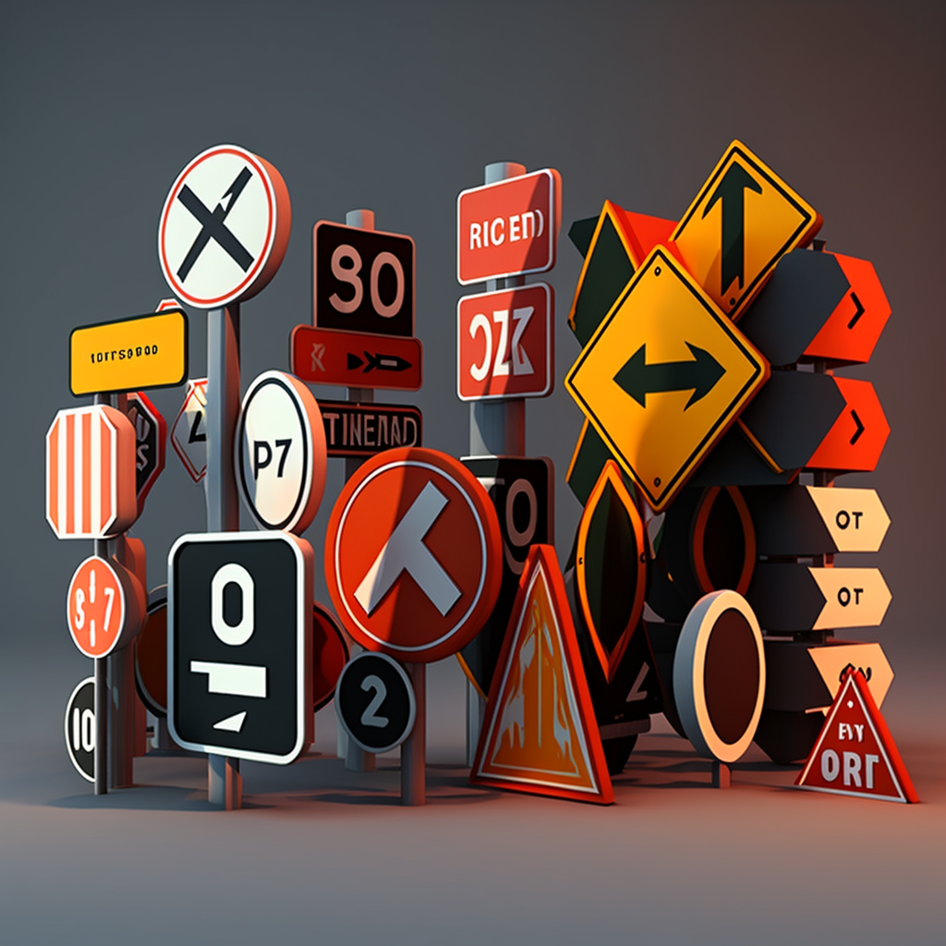
Outline
Introduction to Project
Problem Formulation
Objectives of the work
Methodology used
Results and Outputs
Conclusion
Future Scope
References

Slide 3
Introduction to Project
Road sign detection is a computer vision technology that enables machines to identify and recognize traffic signs on roads. With the increase in the number of vehicles on the roads, road sign detection has become an important area of research and development for improving road safety and reducing accidents.
The primary objective of road sign detection is to assist drivers in interpreting the road environment and to provide them with relevant information about the road ahead. This can include information about speed limits, stop signs, yield signs, and other regulatory and warning signs. Road sign detection can also be used in autonomous vehicles to help them navigate safely on the road.
In recent years, there have been significant advancements in road sign detection technology, thanks to the increasing availability of high-quality cameras, powerful computing systems, and sophisticated machine learning algorithms. These advancements have made road sign detection more accurate, reliable, and efficient than ever before.
Overall, road sign detection is a critical technology that has the potential to greatly improve road safety and reduce accidents on our roads.

Slide 4
Road sign detection is the process of identifying and recognizing traffic signs from images or videos captured by cameras installed on vehicles, such as cars or autonomous vehicles.
Road signs are essential for guiding drivers and ensuring their safety on the road. Accurate detection of road signs is crucial for various applications, including intelligent transportation systems, autonomous driving, and advanced driver assistance systems.
Road sign detection typically involves using computer vision techniques, such as image processing, feature extraction, and machine learning, to analyze images or videos and locate the position and shape of road signs. Some of the common road signs that are detected include stop signs, speed limit signs, yield signs, and no parking signs.
The goal of road sign detection is to provide accurate and timely information to the driver or the autonomous vehicle, enabling them to make informed decisions and avoid accidents.
Road sign detection plays a critical role in ensuring the safety and efficiency of driving on the road, and its importance is likely to increase as more autonomous vehicles are deployed on the road.

Slide 5
Problem Formulation
Input: An image or video frame captured by a camera installed on a vehicle.
Output: The position and shape of all road signs present in the image or video frame.
Constraints:
The detection algorithm must operate in real-time to enable timely response of advanced driver assistance systems or autonomous vehicles.
The algorithm must be robust to variations in lighting conditions, weather, and occlusion, and must be able to detect signs of different shapes, sizes, and colors.
The algorithm must be accurate and have a low false positive rate, to avoid providing incorrect or misleading information to the driver or autonomous system.
The algorithm must be able to handle a range of different road sign types, including stop signs, speed limit signs, yield signs, and no parking signs, among others.
The problem of road sign detection involves detecting and recognizing road signs from images or video frames captured by a camera, and requires the use of various computer vision techniques and machine learning algorithms to achieve accurate and real-time detection capabilities.

Slide 6
Objectives of the Work
To create a system that can automatically recognize the traffic signs has been need to reduce traffic accidents and to drive more freely.
Collect a large dataset of road sign images and annotate them with labels identifying the type of sign.
Pre-process the data to improve the quality of the images, such as removing noise and distortion.
Select an appropriate machine learning algorithm, such as CNN, MobilenetV2, to train a model on the annotated dataset.
Train the selected model on the annotate dataset to learn to recognize road signs.
Evaluate the performance of the trained model on a separate dataset to assess its accuracy, precision, and recall.
Deploy the system in a real-world environment and monitor its performance to identify any issues or areas for improvement.

Slide 7
Methodology Used
Image acquisition: The first step in road sign detection is to acquire images of the road environment using cameras or other sensors. The images should be of high quality and should cover a wide area to ensure that all road signs are captured.
Preprocessing: Once the images are acquired, they need to be preprocessed to remove noise, correct for distortion, and enhance the contrast of the road signs. This can involve techniques such as image filtering, edge detection, and histogram equalization.
Feature extraction: Next, the preprocessed images are analyzed to extract features that are relevant to road sign detection. This can include color, shape, size, and texture features.
Training: In order to detect road signs, a machine learning algorithm needs to be trained on a dataset of annotated images. The algorithm learns to recognize patterns in the features extracted from the images and can then use these patterns to classify new images as containing a road sign or not.
Detection: Once the machine learning algorithm is trained, it can be used to detect road signs in new images. The algorithm analyzes the features of each image and predicts whether it contains a road sign or not. If a road sign is detected, the algorithm can also identify its type and location.

Slide 8
Postprocessing: Finally, the detected road signs need to be postprocessed to remove false positives and ensure that the correct signs are identified. This can involve techniques such as non-maximum suppression and thresholding.
Overall, the methodology of road sign detection involves acquiring images, preprocessing them, extracting features, training a machine learning algorithm, detecting road signs, and postprocessing the results. This process can be iterative and may require adjustments to the algorithm or preprocessing techniques to improve the accuracy of the detection.

Slide 9
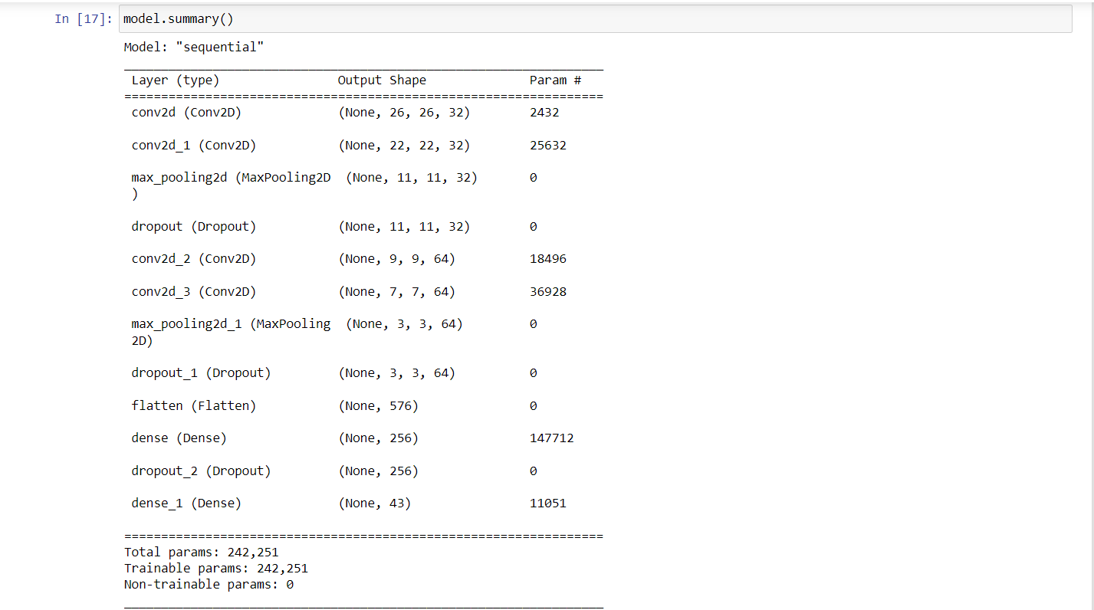
Results and Outputs

Slide 10
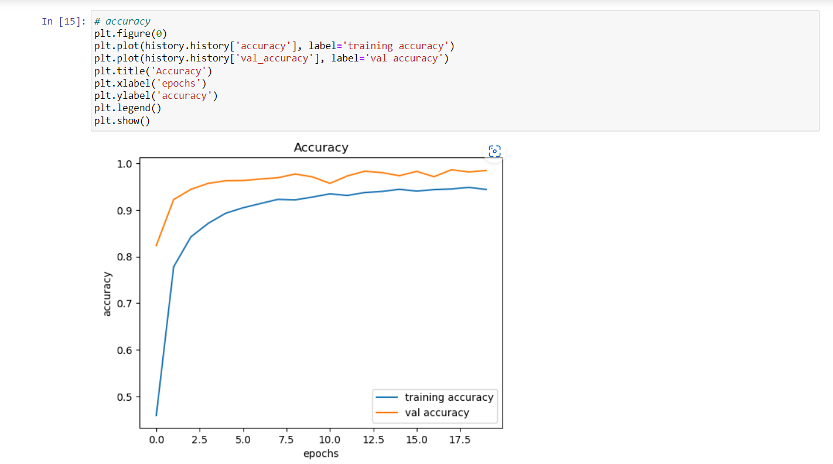

Slide 11
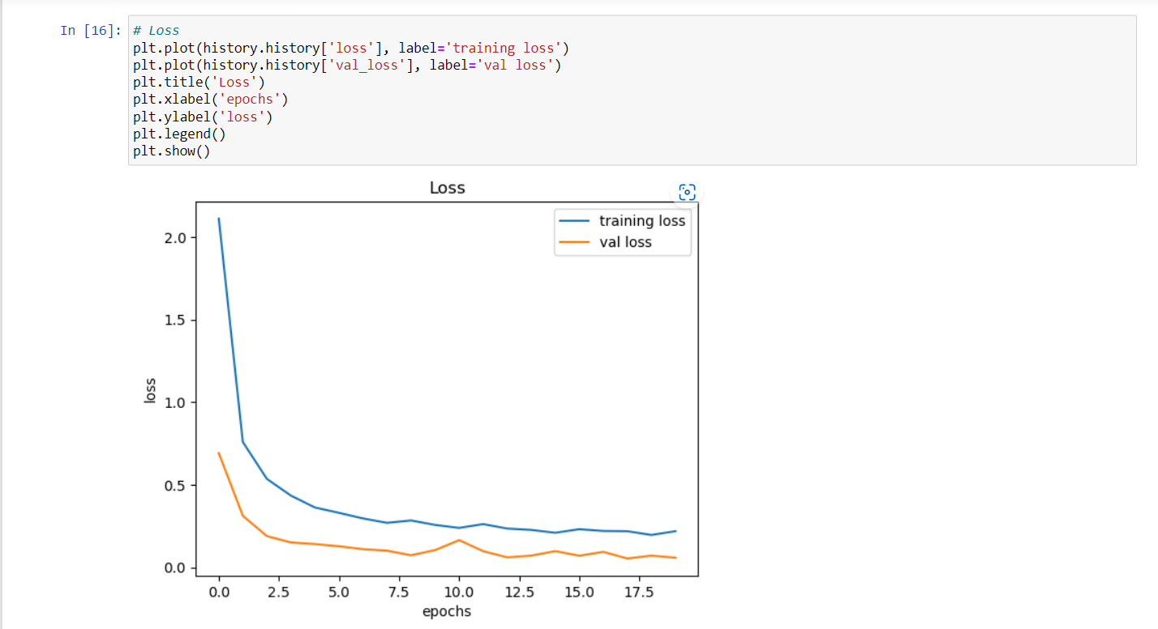

Slide 12
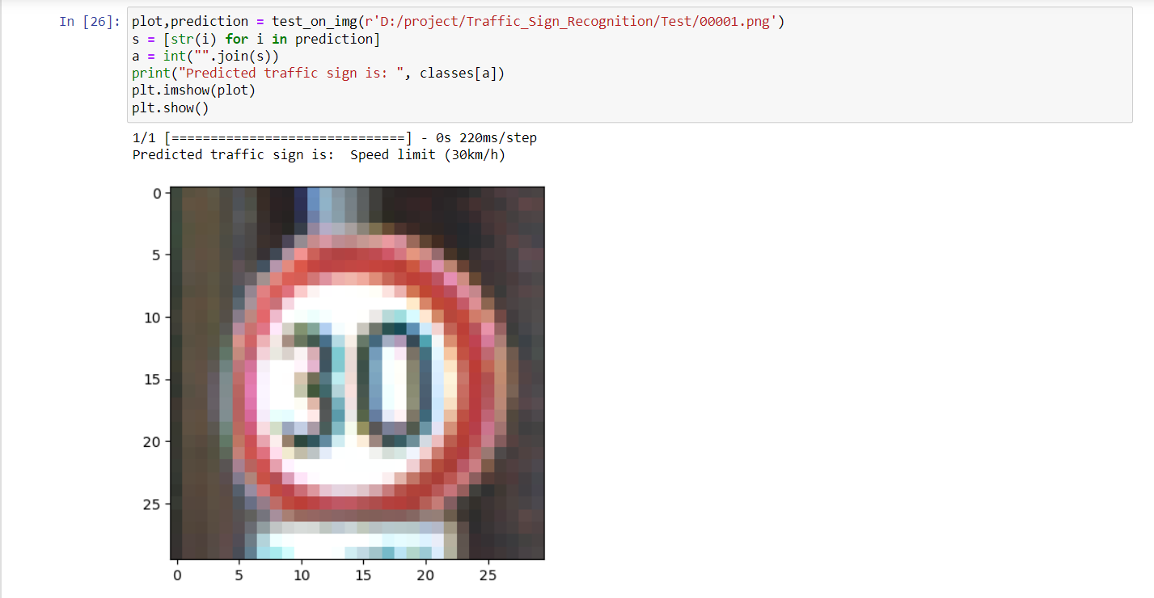

Slide 13
Conclusion
Road sign detection is an important technology that has the potential to greatly improve road safety and reduce accidents. By using computer vision algorithms to detect and recognize traffic signs, road sign detection systems can provide drivers with critical information about the road ahead, such as speed limits, stop signs, and other regulatory and warning signs.
Implementing a road sign detection project requires a combination of hardware and software components, including cameras or other sensors, powerful computing systems, and sophisticated machine learning algorithms. The methodology for road sign detection involves acquiring images, preprocessing them, extracting features, training a machine learning algorithm, detecting road signs, and postprocessing the results.
While there have been significant advancements in road sign detection technology in recent years, there are still challenges that need to be addressed, such as detecting signs in poor weather conditions or in complex road environments. However, with continued research and development, road sign detection has the potential to become even more accurate, reliable, and efficient, and to greatly improve road safety for drivers and passengers alike.

Slide 14
Future Scope
Improved accuracy: With continued research and development, road sign detection algorithms are likely to become even more accurate, reliable, and efficient.
Real-time processing: Real-time road sign detection is a key area of research, as it could enable systems to provide drivers with immediate feedback about the road environment.
Integration with other systems: Road sign detection can be integrated with other systems, such as autonomous vehicles or smart city infrastructure, to provide a more complete understanding of the road environment.
Multi-modal sensing: In addition to cameras, road sign detection could be combined with other sensors, such as radar, to improve performance in challenging environments or in low-visibility conditions.
Edge computing: Edge computing involves processing data on devices at the edge of the network, such as cameras or sensors, rather than in the cloud.

Slide 15
References
Traffic Sign Recognition for Computer Vision Project-Based Learning David Gerónimo, Joan Serrat, Antonio M. López, Member, IEEE, and Ramon Baldrich, August 2019
Road traffic sign detection and classification, A. De la Estalera, L.E.Moreno M.A.Salichs, J.M.Armingol, IEEE,December 1997.
An Automatic Traffic Sign Detection and Recognition System Based on Color Segmentation, Shape Matching, and SVM - Research Article,Safat B. Wali, Mahammad A. Hannan, Aini Hussain, and Salina A. Samad, November 2015.
R. Szeliski, Computer Vision: Algorithms and Applications. New York, NY, USA: Springer, 2010. G. Bebis, D. Egbert, and M. Shah, “Review of computer vision education,” IEEE Trans. Educ., vol. 46, no. 1, pp. 2–21, Feb. 2003.
P. Reimer, A. Albu, and G. Tzanetakis, “Raydiance: A tangible interface for teaching computer vision,” in Proc. 7th ISVC, Las Vegas, NV, USA, 2011, vol. 2, pp. 259–269.
C. Fang, S. Chen, and C. Fuh, "Road-sign detection and tracking," IEEE Trans. on Vehicular Technology, vol. 52, pp. 1329-1341, 2003.
J. Miura, T. Kanda, and Y. Shirai, "An active vision system for real-time traffic sign recognition," presented at 2000 IEEE Intelligent Transportation Systems, Dearborn, MI, USA, 2000.
S. Vitabile, A. Gentile, G. Dammone, and F. Sorbello, "Multi-layer perceptron mapping on a SIMD architecture," presented at The 2002 IEEE Signal Processing Society Workshop, 2002.
S. Vitabile, G. Pollaccia, G. Pilato, and F. Sorbello, "Road sign Recognition using a dynamic pixel aggregation technique in the HSV color space," presented at 11th Inter. Conf. Image Analysis and Processing, Palermo, Italy, 2001.
P. Paclik and J. Novovicova, "Road sign classification without color information," presented at Sixth Annual Conf. of the Advanced School for Computing and Imaging, Lommel, Belgium, 2000.
P. Paclik, J. Novovicova, P. Pudil, and P. Somol, "Road sign classification using Laplace kernel classifier," Pattern Recognition Letters, vol. 21, pp. 1165-1173, 2000.
E. Perez and B. Javidi, "Composite filter bank for road sign recognition," presented at 13th Annual Meeting IEEE Lasers and Electro-Optics Society, Rio Grande, Puerto Rico, 2000.

Slide 16


